Slide 1
ISM Assignment Name: Pamidi Pradeep Kumar BITS ID: 2018AB04152 Assignment files (Jupyter Notebook, Excel Spreadsheet & PPT) available at: https://github.com/pamidipradeep/ISMAssignment

Slide 2
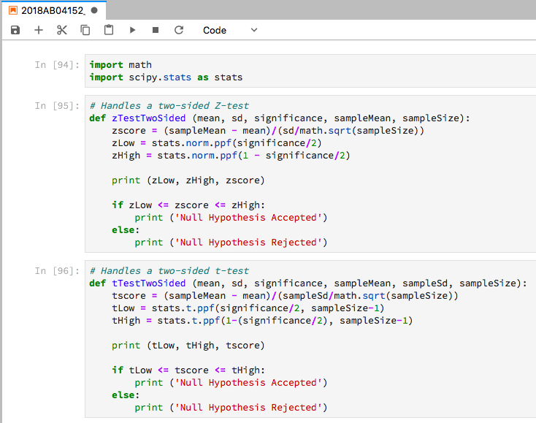
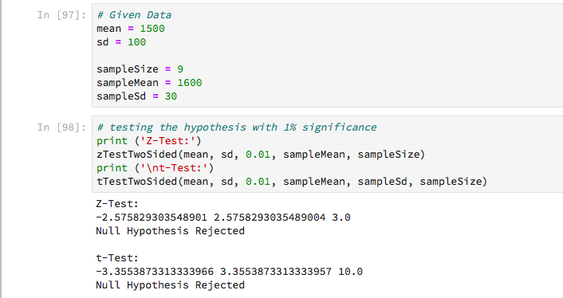
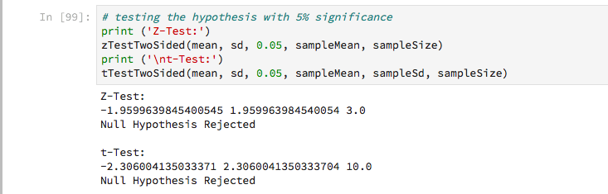
Question 1:
Python code to test the hypothesis using z and t-tests
Functions defined handle two sided tests.
zTestTwoSided function handles z-test
tTestTwoSided function handles t-test
First the functions are called with significance of 1%.
Later the functions are called with significance of 5%
Results: both z-test and t-test fail the hypothesis test for both 1% and 5% significance.
Hence, Null hypothesis is rejected.

Slide 3
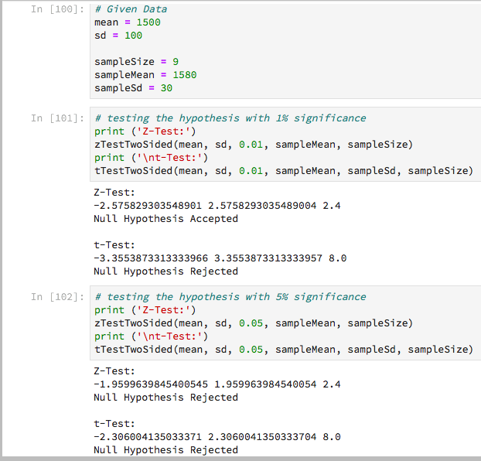
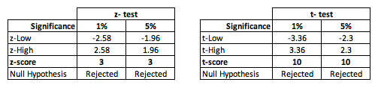
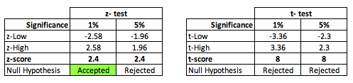
Null Hypothesis (H0): The mean strength of the cable is 1500.
Alternate Hypothesis (H1): The mean strength of the cable is not 1500.
Hypothesis testing for 1% and 5% significance for z-test and t-test results in the following table:
Extra experiment: To understand the tests better, ran the hypothesis test program for Sample Mean = 1580. Here, the Z-test passes for 1% significance while t-test fails.
Observations:
Both Z and t statistic for the sample mean is outside the acceptance limits. Hence Null hypothesis is rejected.
This implies the mean cable strength is not equal to 1500 as claimed.
In a two-sided test, any test that fails at lower significance value will fail at higher significance.
The t-test has a more flatter curve than the z distribution for degrees of freedom = 8. (based on the scale of the scores)
Comments:
z-test assumes the sample follows normal distribution, but for small sample sizes this is not true (central limit theorem) and tends to have a more flat distribution than the normal bell curve.
Using a wrong statistic leads to wrong decision. Its important to choose the appropriate statistic for the test.
Suggestions:
Apply t-test for smaller sample sizes. N<30
Apply z-test for large sample sizes. N>30
Multiple tests would result is a more reliable hypothesis testing than one sampling test.
At smaller sample sizes the distribution is not normal, but flatter.
Using z-test for smaller samples sizes could give wrong hypothesis, as shown in this above experiment.

Slide 4
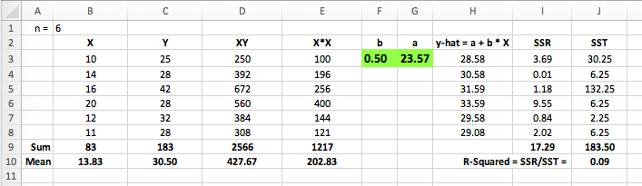
Question 2:
Implementation of Linear Regression in Excel:
Plot of the data and the regression line
Equations used:
Blue- data points
Red – regression line
Linear regression arrived at for Y is: Y-hat = 23.57 + 0.50 * X
Next slide: Polynomial Regression >

Slide 5
Regression with different degrees of the polynomial
Observations:
Linear regression appears underfitting the data which can be arrived at due to very low R-square value of 0.09.
3rd, 4th and 5th order polynomial regression line overfits the data. R-squared values closer to 1 is an indicator of overfitting as it means there is less scope for errors which is highly unlikely when the sample size is small.
2nd order polynomial regression, appears to balance the bias and variance well.
For the given data, the second order polynomial appears to be a preferred model.
Conclusion:
2nd order polynomial regression models the data better. The regression equation is:
Y-hat = -0.361 X² + 11.326 X + 52.949
2nd order polynomial
3rd order polynomial
4th order polynomial
5th order polynomial
Blue- data points
Red – regression line

